Slide 1

Adventure works INSIGHT PROJECT
Group 2
Mr. Mobin. Khan
Mr. Sai Pavan .Andrajula
Ms. Sanskruti .Patkar
Ms. Nikhila. Duggineni
Mr. Sarvesh. Ghadi
Ms. Jinal. Sangani
Ms. Farheen. Munshi

Slide 2
introduction
Adventure works company is a company that manufactures and sells different varieties of bikes and bike gears to commercial market in different parts of world. The company has provided us various types of tables and data to support bicycle manufacturing company operations.
This presentation will explore the key performance indicators and insights derived from sales and profits, customers demand, highest selling regions and operational efficiency.
By the end of this project, we will understand how data visualization and analysis can enhance business strategies and increase overall performance.

Slide 3
Key performance indicators (kpi’s) and insights
To understand the kpi’s and insights of the company, we delved into the data provided and by using different tools we were able to analyze, transform, extract the raw data into high quality reports, trends, and dashboards. Tools used were Excel, Tableau, Power BI and SQL.
The highest product sales was for Mountain 100 Silver Bike shown in Tableau Dashboard.
The best sales happened in 2013 shown in Tableau and Excel Dashboards.
The best region of sales is North America shown in Excel Dashboard.
The best quarter for financial performance was in Q4 as shown in Excel Dashboard

Slide 4
Key performance indicators (kpi’s) and insights
The highest rate of new customers was in the year 2013 as shown in Power BI.
Highest selling products are Road Bikes and lowest selling products were helmets when the charts were observed in Sales vs Profit for products in Power BI.
With SQL, we were able to evaluate the total sales for each consecutive year(2010-2014).
Highest and the lowest of the total sales was distinguished by SQL tool.

Slide 5
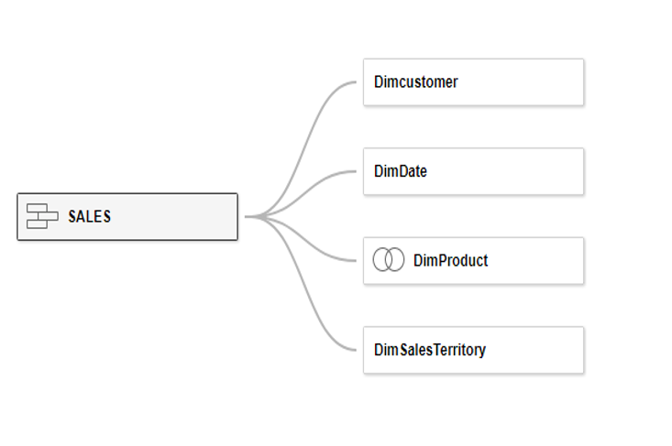
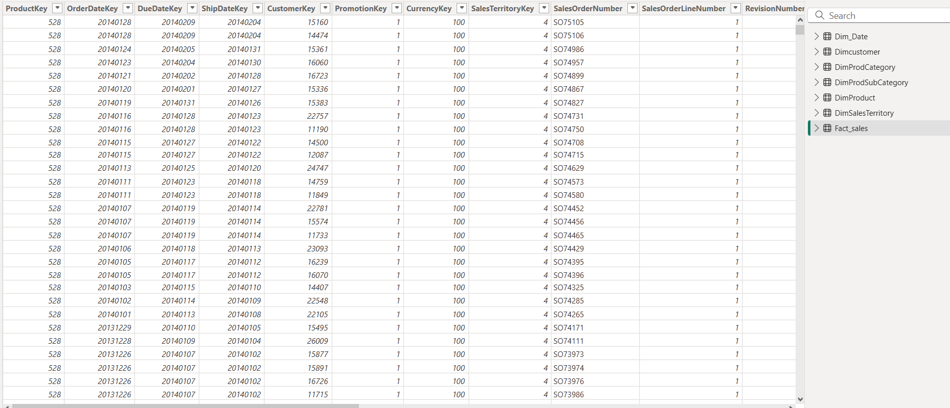
Data model
Raw data

Slide 6
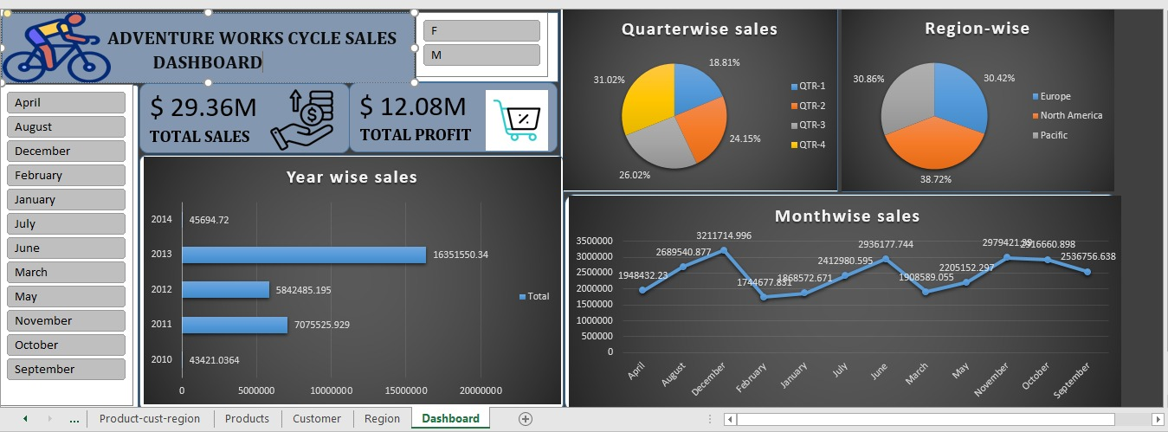
Excel dashboard

Slide 7
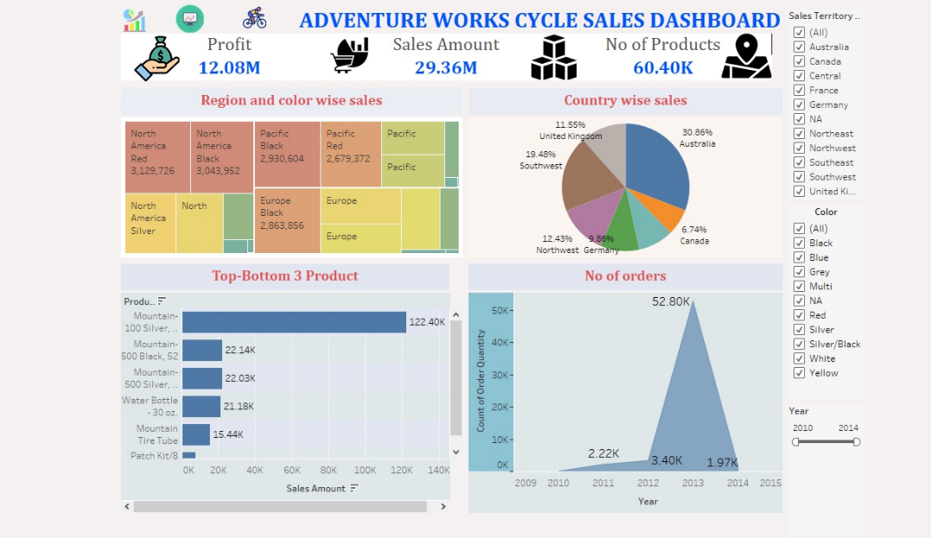
tableau

Slide 8
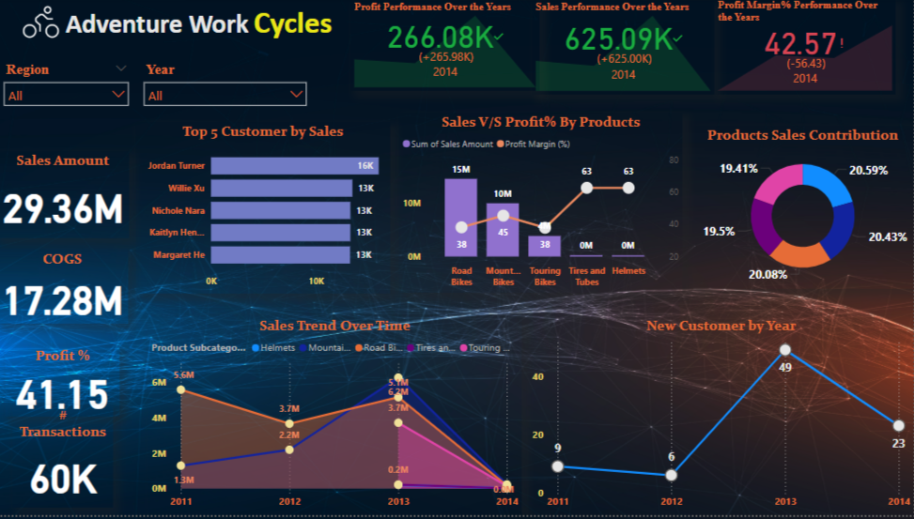
Power bi

Slide 9
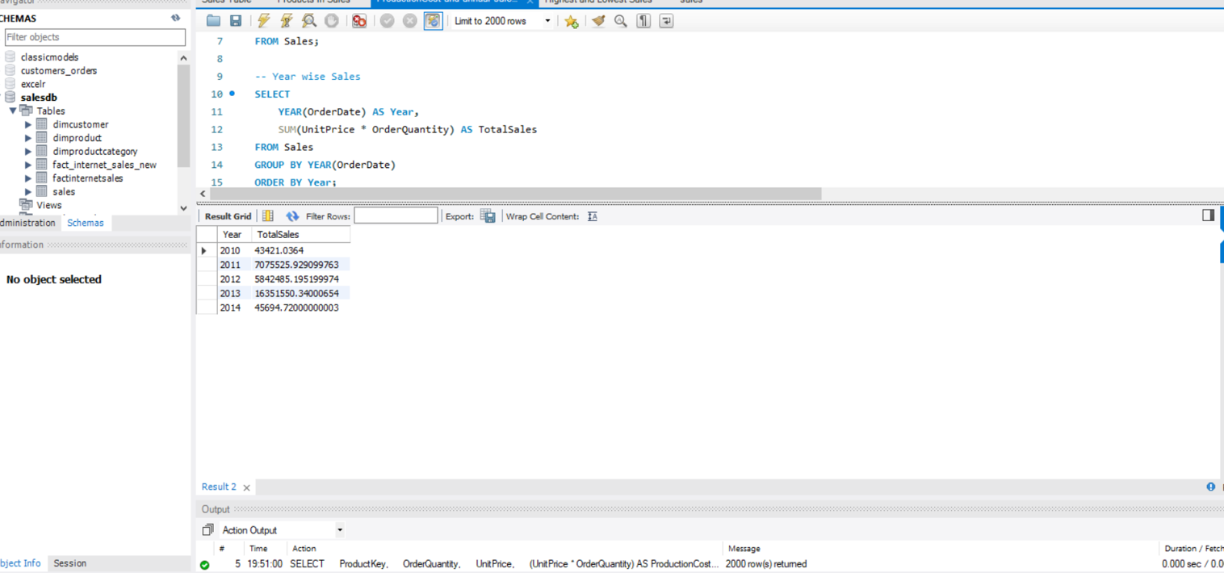
SQL qUERY

Slide 10
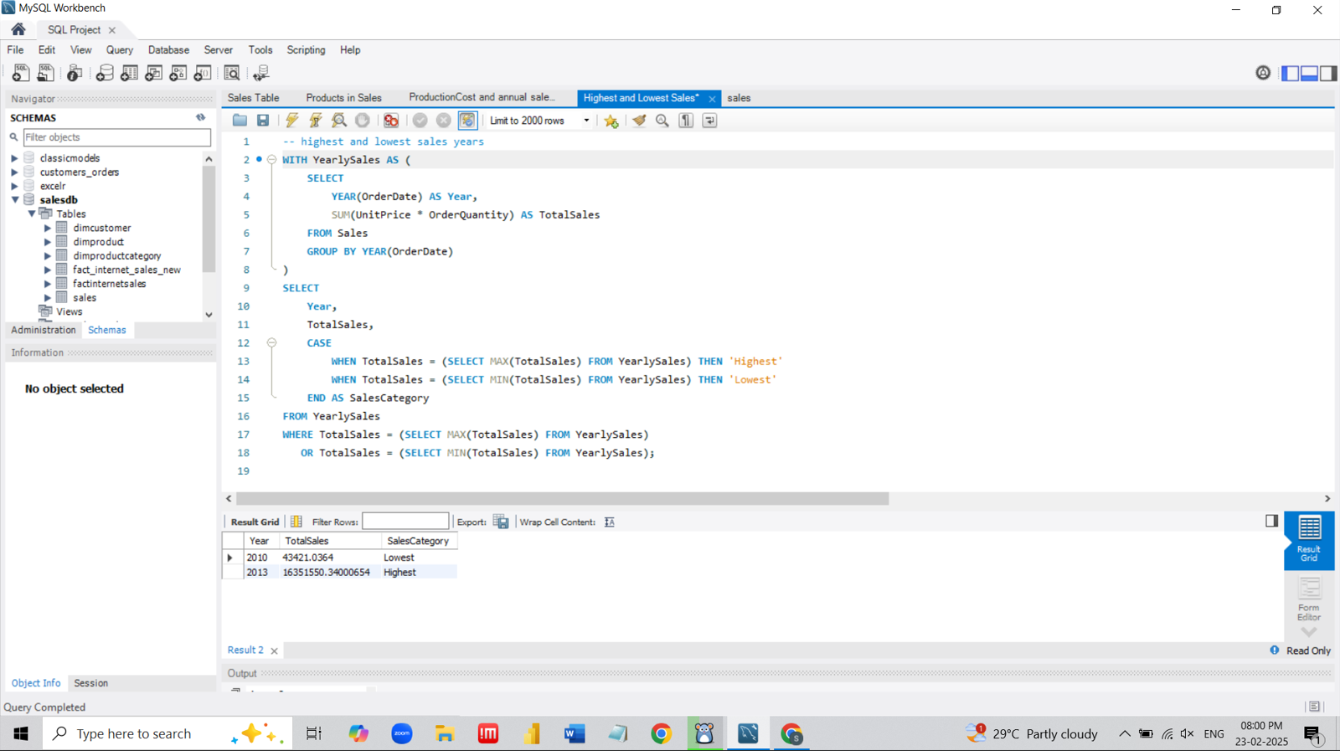

Slide 11
Conclusion
Adventure Works Bicycles sales data had actionable insights, good forecasting efficiency, and can help management make future strategic decision–making ideas.
The presented KPIs offer a glimpse into the vast potential for improved sales and growth within their business. By harnessing the power of the data, we can drive positive changes, ensuring a bright future for Adventure Works.
KEY LEARNINGS
Focus on the top selling product and continue to offer more discounts and sales offers during Fiscal Q4 to drive more business growth.
Work on increased marketing and advertising in North America

Slide 12
THANK YOU

